Slide 1
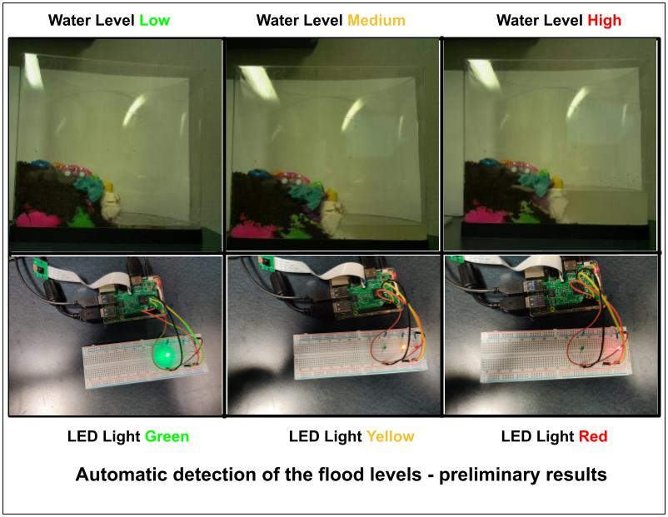

Flood Detection using Raspberry Pi
Presented By,
Mohammed Nauman Siddique
Department of Computer Science
OLD Dominion University
Spring 2021
2021-03-12

Slide 2
Introduction
measure the flooding levels using Raspberry PI
compare images and turn on the respective LED to alert the user.

Slide 3
LED Light Interpretation
LED Light | Water Level | Threat Level
Green | Low | Safe
Yellow | Medium | Alert
Red | High | Danger

Slide 4
Results from the Project

Slide 5
Equipment for the project
Fish Tank
Raspberry Pi (3 or 4)
Raspberry Pi Camera
Bread Board
Three LED Lights (Red, Yellow, and Green)
Resistors (Minimum 3)
Jumper Wires

Slide 6
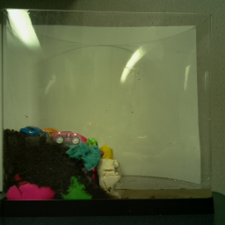
Fish Tank Model
White Background
Land
Water

Slide 7
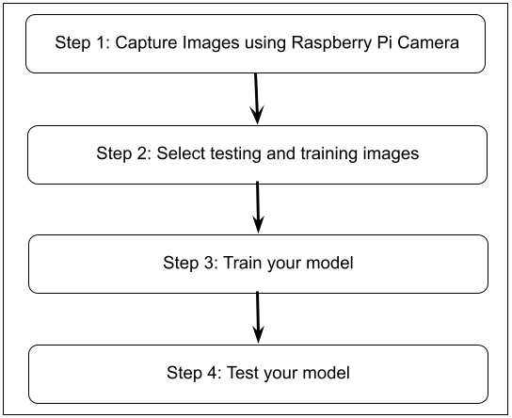
Flood Detection Architecture

Slide 8
Assumptions of the Project
capture 256 * 256 pixel images
project simulated on a fish tank
Use white background for the fish tank to avoid grey scale image conversion issues
captured images must capture the entire fish tank
more than 90% of the image must be the fish tank to reduce the surrounding noise for better results

Slide 9
Code Snippet for capturing Images
camera = picamera.PiCamera() # Setup a Picamera Object
camera.resolution = (256, 256) #Capture 256*256 resolution images
camera.start_preview() # Open Camera Preview
time.sleep(2) # Freeze the preview for 2 seconds
camera.capture(os.path.join(os.getcwd(), "images", "testing", imageName)) # Capture images and write to a file location

Slide 10
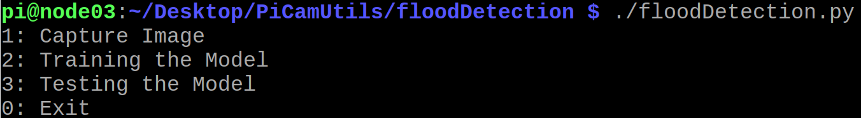
Menu of the Program

Slide 11
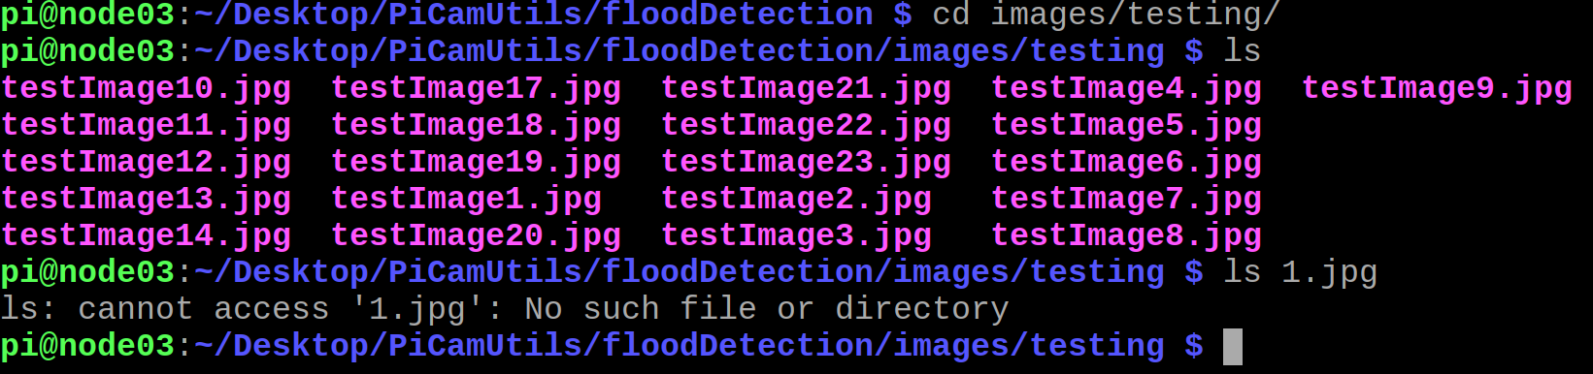
1.jpg file is not present

Slide 12
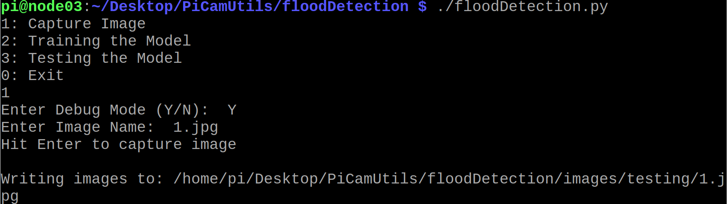
Capture Image using Option 1

Slide 13
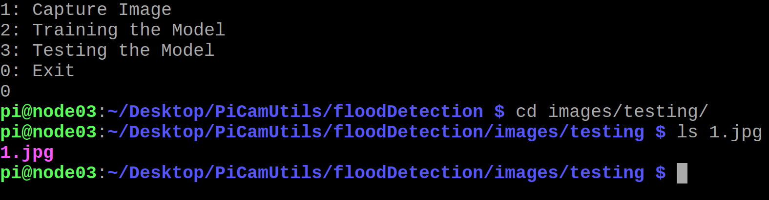
Validate 1.jpg file

Slide 14
Captured 21 testing images
We captured 21 training images using Option 1.
Full List of images: https://github.com/isaki001/PiCamUtils/tree/master/floodDetection

Slide 15
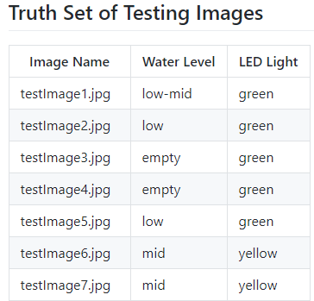
Truth set of captured images Available at: https://github.com/isaki001/PiCamUtils/tree/master/floodDetection

Slide 16
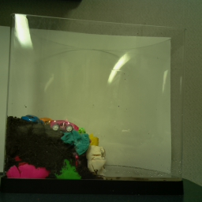
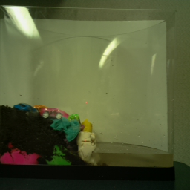
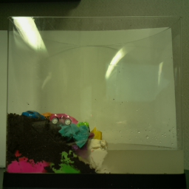
Training the model (Select three images, one for low, one for medium, and one for high water level)
Water Level Low
Water Level Medium
Water Level High

Slide 17
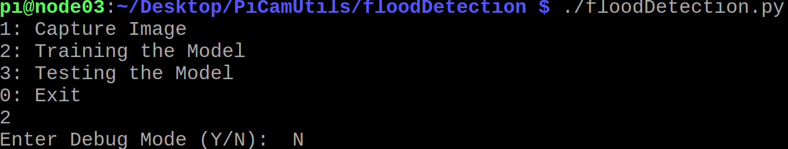
Train the model using option 2

Slide 18
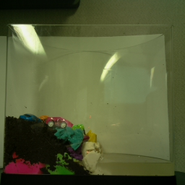
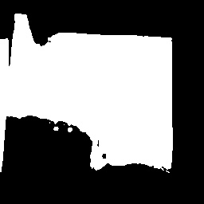
Basic about Greyscale Images and Pixel Values
0
255
Image Height
in Pixels
0
255
0
Image Width
in Pixels
255

Slide 19
Use the image to find pixel values of fish tank, land level, and water level
Step 1: Select a 256*256 image
Step 2: Convert it to Greyscale Image
Step 3: Find the fish tank top and bottom pixel values: tankTop and tankBottom
Step 4: Find the water level pixel value : waterLevel
Step 5: Find the highest point on the land pixel value : landLevel
Step 6: Compute scaling ratio (Tank Height / 255), since 255 is the height of image in pixel value
Tank Height = (tankTop – tankBottom)
Scaling Ratio = Tank Height / 255

Slide 20
Computation of Fish Tank Pixel Values
0
tankTop
Image Height
in Pixels
landLevel
waterLevel
tankBottom
255

Slide 21
Compute flood detection parameter values
Step 7: Compute Water Level Height
Water Height = (tankBottom - waterLevel) / Tank Height
Step 8: Compute Land and Water Height Difference
Land Height = (tankBottom - landLevel) / Tank Height
Height Difference = (Land Height – Water Height) / Tank Height
Step 9: Compute Water and Land Ratio
Water to Land Ratio = Water Height / Land Height

Slide 22
Computed Training Values
Water Level | Water Height | Height Difference | Water to Land Ratio
Low | 0.035 | 0.227 | 0.134
Medium | 0.071 | 0.188 | 0.273
High | 0.145 | 0.165 | 0.468

Slide 23
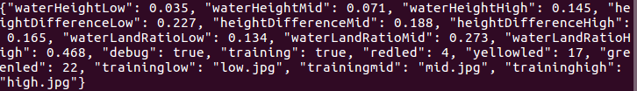
Write the training values to a serialized configuration object

Slide 24
Configuration File (Low and Medium Water Levels) - Part 1
[LOW] // Stores low water level values
WATER: -1 // Water Height
DIFFERENCE: -1 // Height Difference
RATIO: -1 // Water Land Ratio
[MID]
WATER: -1
DIFFERENCE: -1
RATIO: -1

Slide 25
Configuration File (Hight Water Level and LED Lights)
[HIGH]
WATER: 0.2
DIFFERENCE: 0.8
RATIO: -1
[LED] // Stores the Raspberry Pi GPIO Pin number for LED lights
RED: 4
YELLOW: 17
GREEN: 22

Slide 26
Configuration File (Training Images)
[TRAINING] // Stores the training image names
LOW: low.jpg
MID: mid.jpg
HIGH: high.jpg

Slide 27
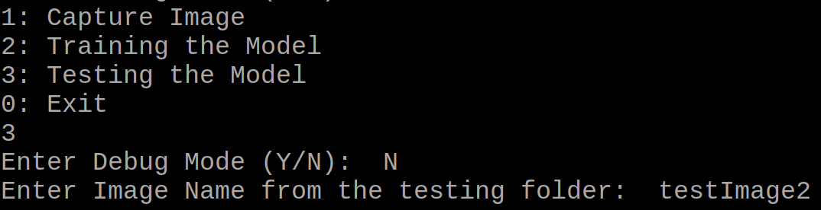
Train the model using option 3

Slide 28
How testing is done?
Step 1: Read the serialized Configuration object containing training values
Step 2: Compute Water Height, Height Difference, and Water to Land Ratio for the testing Image
Step 3: Compare the computed values against the training values of all the three parameters
Step 4: Each parameter returns a predicted water level
Step 5: Use the best of three water level as predicted water level
Water Height: Red Height Difference: Yellow, Water to Land Ratio: Red → Predict: Red
Water Height: Red Height Difference: Yellow, Water to Land Ratio: Green → Predict: Error

Slide 29
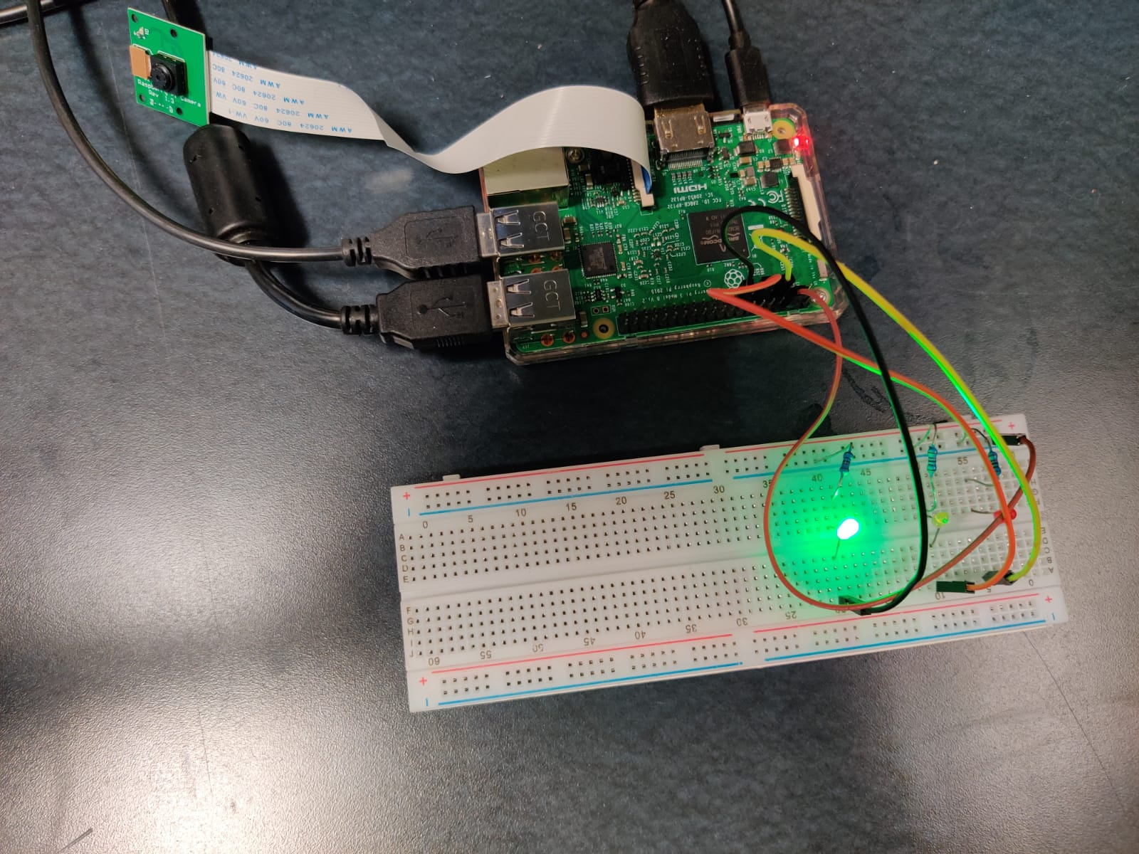
Testing Water Level Low

Slide 30
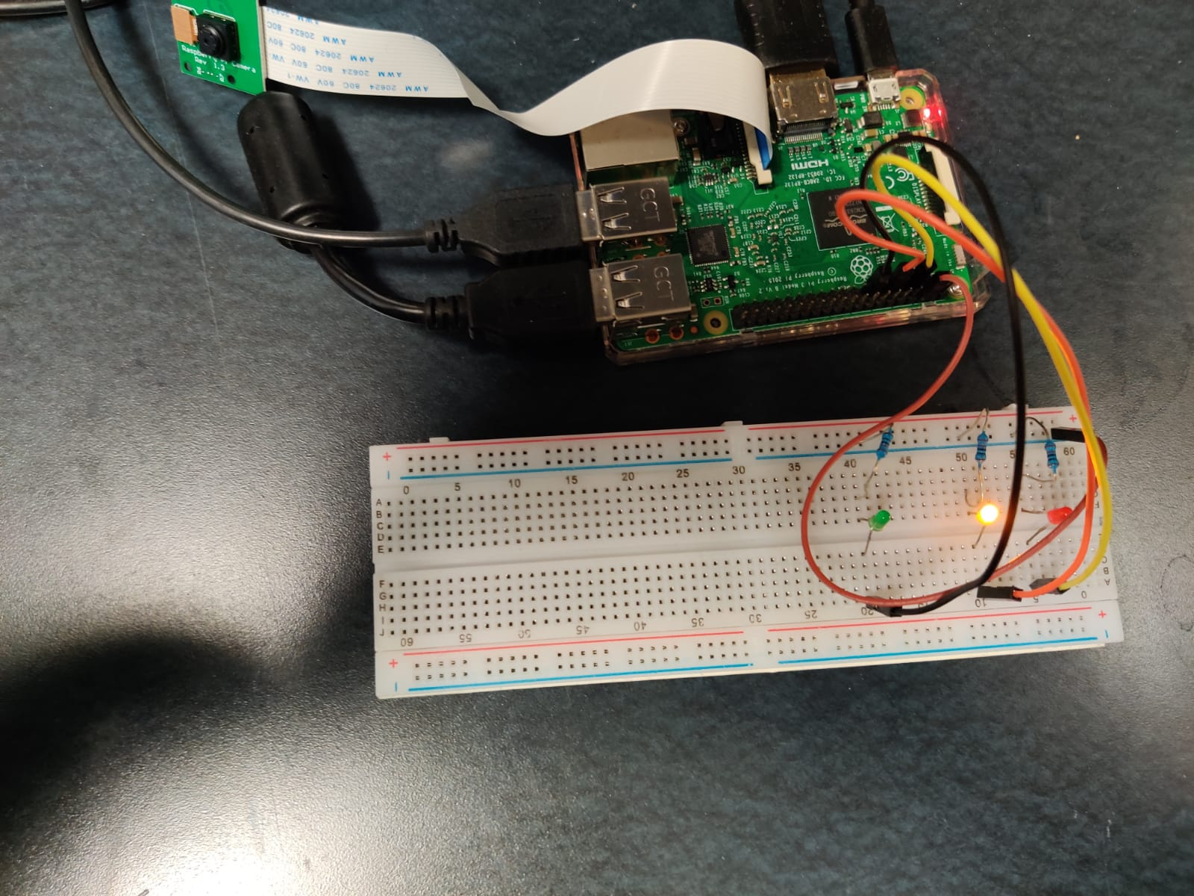
Water Level Medium

Slide 31
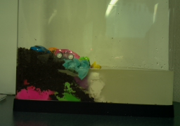
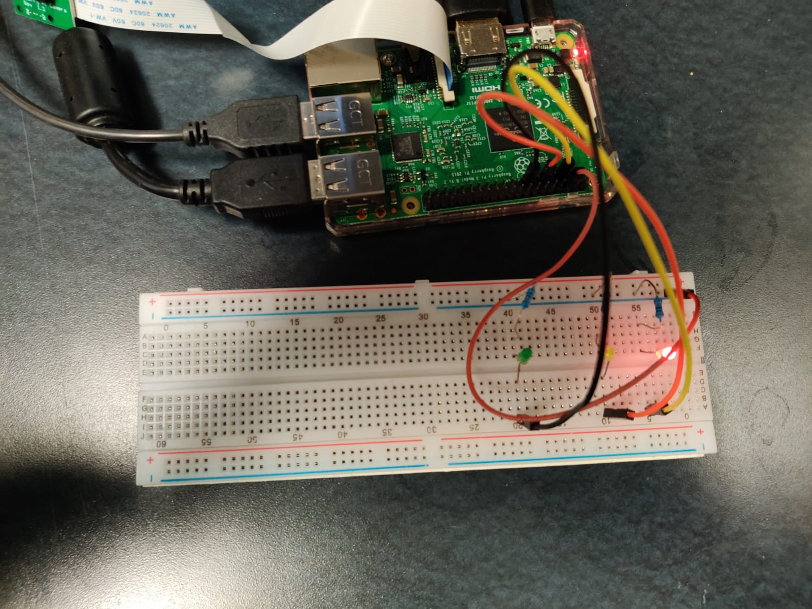
Testing Water Level High

Slide 32
Results of the Project
Of the 21 Testing Images only one image is predicted with wrong water level.
Our model predicts testImage14.jpg as water level high while the actual water level is medium.

Slide 33
Project Dependencies
Python3 (Programming Language)
picamera (library for capturing images using Raspberry Pi camera)
OpenCV (library for image processing)
gpiozero (library for using LEDs with Raspberry Pi)

Slide 34
Project Code Description
.
├── images
│ ├── testing # Testing Images
│ ├── training # Training Images
├── watertank.py # Code for measuring water tank level and turning the respective LED lights
├── configmanagement.py # Read and writing configuration files
├── configuration
│ ├── config.ini # Configuration file
│ ├── config # Serialized Config object

Slide 35
Code Available at: https://github.com/isaki001/PiCamUtils/tree/master/floodDetection

Slide 36
Conclusion
Project for measuring the flooding levels using Raspberry PI by comparing images and turn on the respective LED to alert the user.
Project completed with a flood detection simulation model using Raspberry Pi with approx. 95% accuracy.

